Slide 1
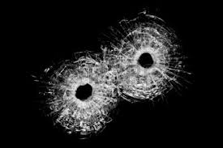
Kent State Massacre
By: Madeline Aesoph

Slide 2
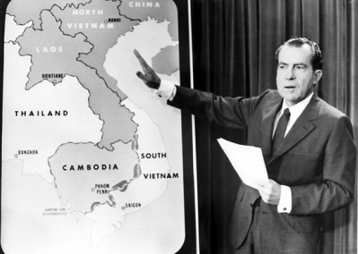
The Invasion of Cambodia.
Vietnam War was thought to be winding down.
Richard Nixon made a television address on April 30th to announce the invasion of Cambodia.
The new invasion of Cambodia angered many who believed the war was coming to an end.

Slide 3
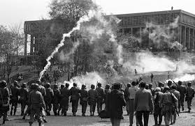
May 1st
A demonstration was held with about 500 students in the center of Ken State.
They planned a protest against the expansion of Vietnam into Cambodia for May 4th.
Trouble started that night when people were leaving a bar and started throwing beer bottles at police cars and breaking downtown store fronts.
By the time Police arrived 120 people were crowded and had started a fire in the street
Police succeeded in using tear gas to disperse the riot from downtown.

Slide 4
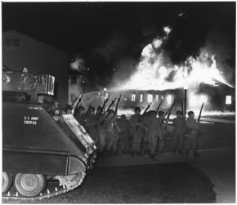
May 2nd
City officials and businesses were receiving threats
The governor called in the Ohio National Guard to be sent to Kent
By the time that the national guard arrived, a large riot was already underway at Kent State University.
The Capus Reserve Officer Training Corps building was on fire and more than a thousand protesters surrounded the burning building cheering.
The national guard used tear gas and made several arrests before the riot dispersed

Slide 5
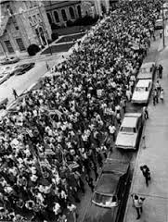
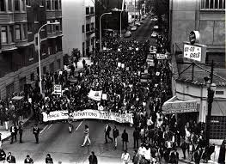
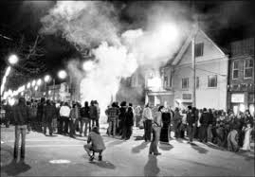
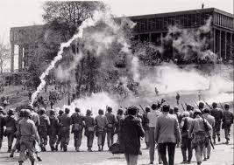
May 3rd
Governor Rhodes held a news conference referring to the Kent State Riots.
8:00 that night another rally was being held and by 8:45 the Guardsman used tear gas to disperse the crowd.
At 11:00 the guards announced that the students had a new curfew to abide by and forced them back to their dorms.

Slide 6
May 4th 1970
On Monday, approximately 2,000 people gathered to protest the Vietnam War.
Companies A and C of the Ohio National Guard came and attempted to disperse the students.
At first they tried to read the rioters an order to disperse or to face arrest. Protesters responded by throwing rocks at the patrolman
The guard then attempted tear gas but it was too windy to be effective.
When the crowd would not disperse guardsmen took out weapons and at 12:24 pm the first shot was fired.
Unarmed college students were shot by the Ohio national guard
The National Guard Killed 4 students and wounded nine others

Slide 7
Those shot were either campaigning or near the campaign to stop the spread of the Civil War.
4 million students went on strike due to the Kent State shooting
Hundreds of Universities, Colleges, and high schools closed due to the strike.

Slide 8
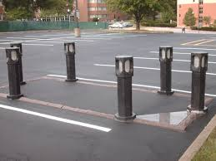
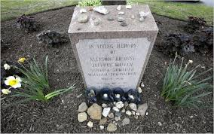
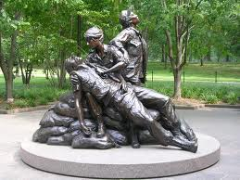
February 23rd 2010 the site of the Kent State shooting was added to the National Registry of Historic Places.
On may 4th 2014 was the 44th Anniversary of the Kent State Massacre
http://fox8.com/2014/05/04/campus-reflects-on-44th-anniversary-of-kent-state-shootings/

